Slide 1
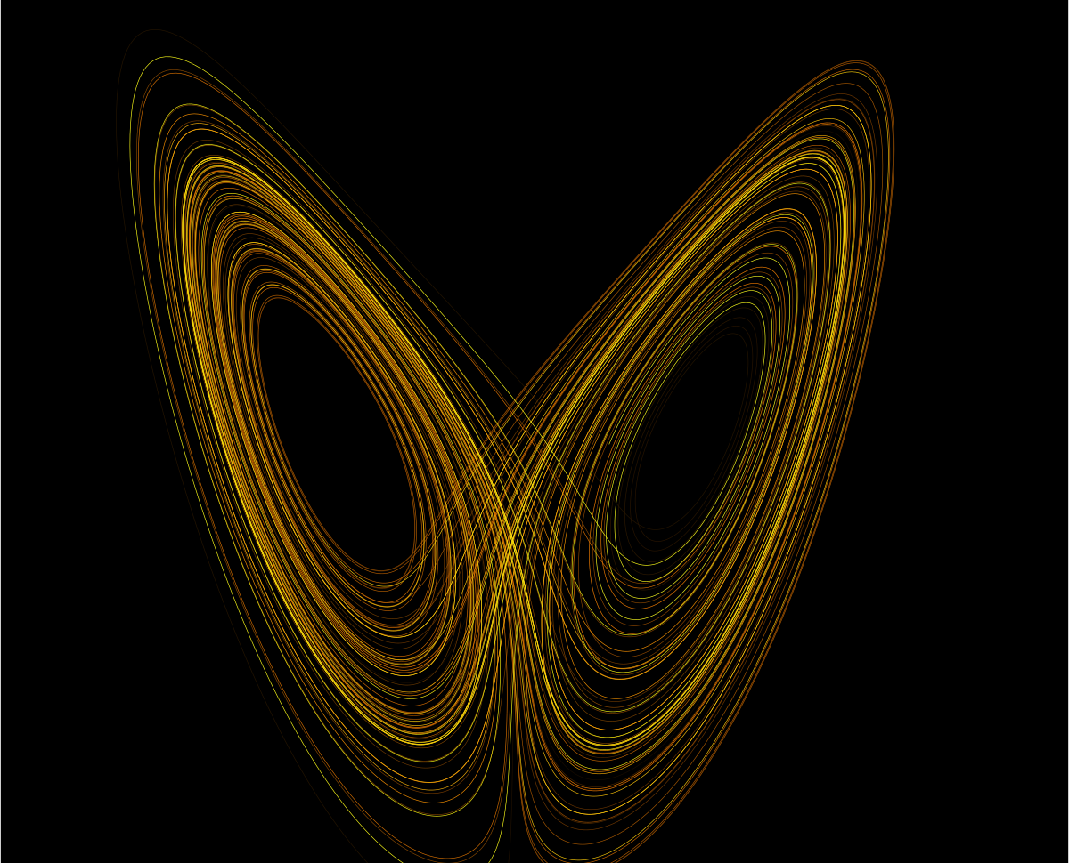
Searching for Chaos in the H-H model
Lorenz attractor
What is chaos?
What is H-H model?
Notes:
NOTE:
To change the image on this slide, select the picture and delete it. Then click the Pictures icon in the placeholder to insert your own image.

Slide 2
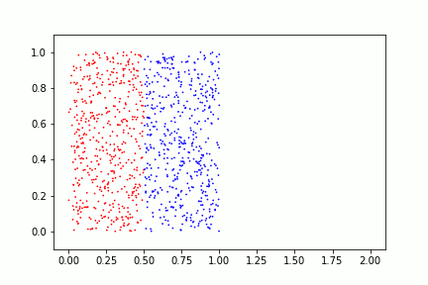
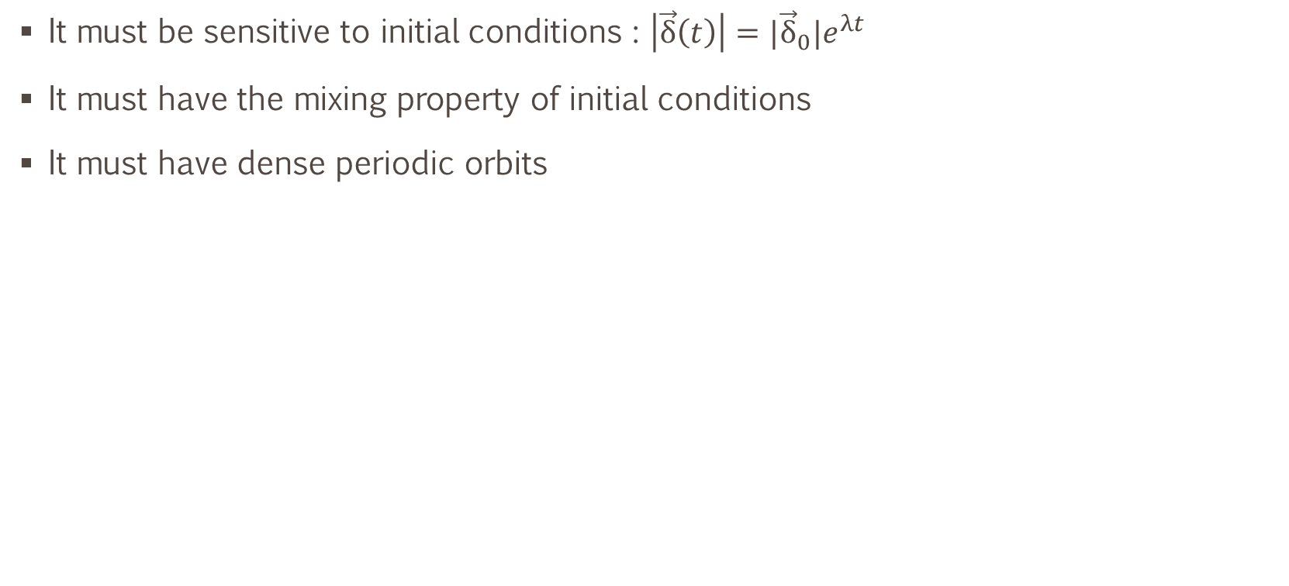
Chaotic system
It must be sensitive to initial conditions : $\left|\vec{δ}\left(t\right)\right|={|\vec{δ}}_{0}|e^{λt}$
It must have the mixing property of initial conditions
It must have dense periodic orbits

Slide 3
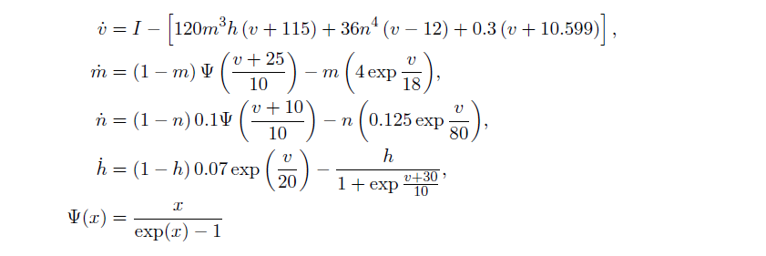
Hodgkin – Huxley Model
The paper I followed:
Chaos in the HH model, John Guckenheimer and Ricardo A. Oliva
https://epubs.siam.org/doi/pdf/10.1137/S1111111101394040

Slide 4
Why does it matter to search for chaos in a single neuron?
We know that a population of neurons, in simple words, has complex and chaotic behaviours. The question can be, is this chaotic property a collective outcome of neural culture or the intrinsic property coming from each neurons?
From a mathematical point of view, it can help us learn more about chaos by exploring it in this system.

Slide 5
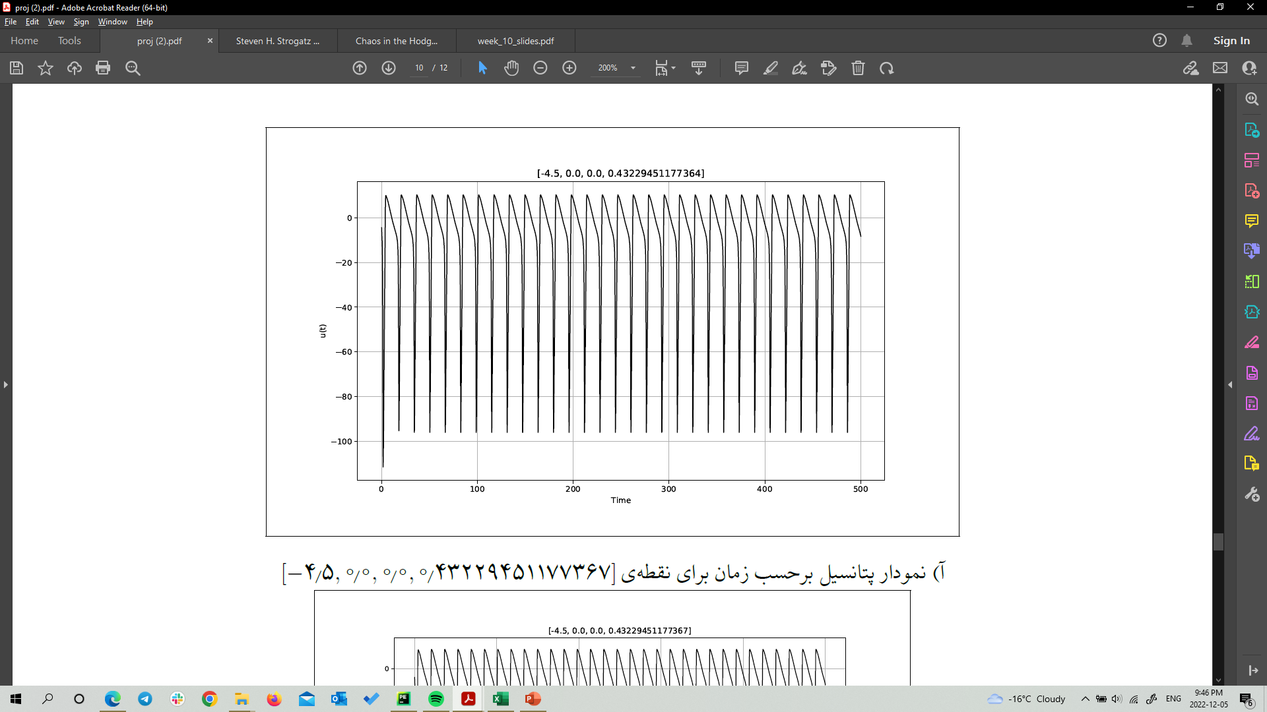
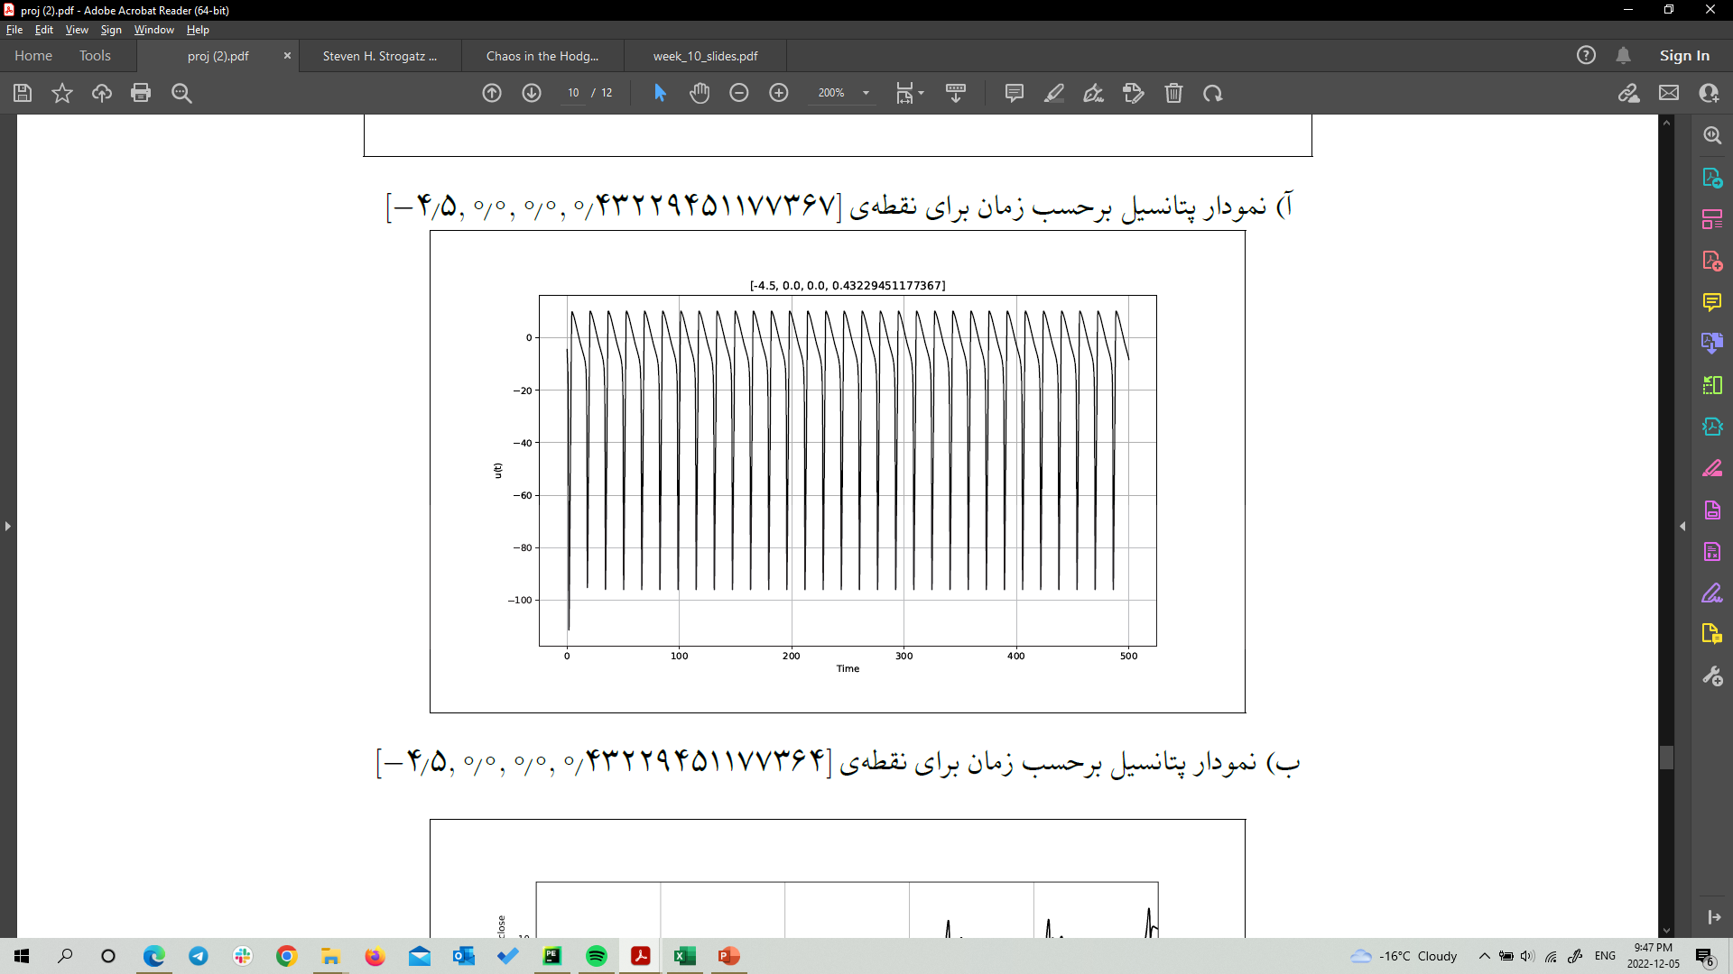
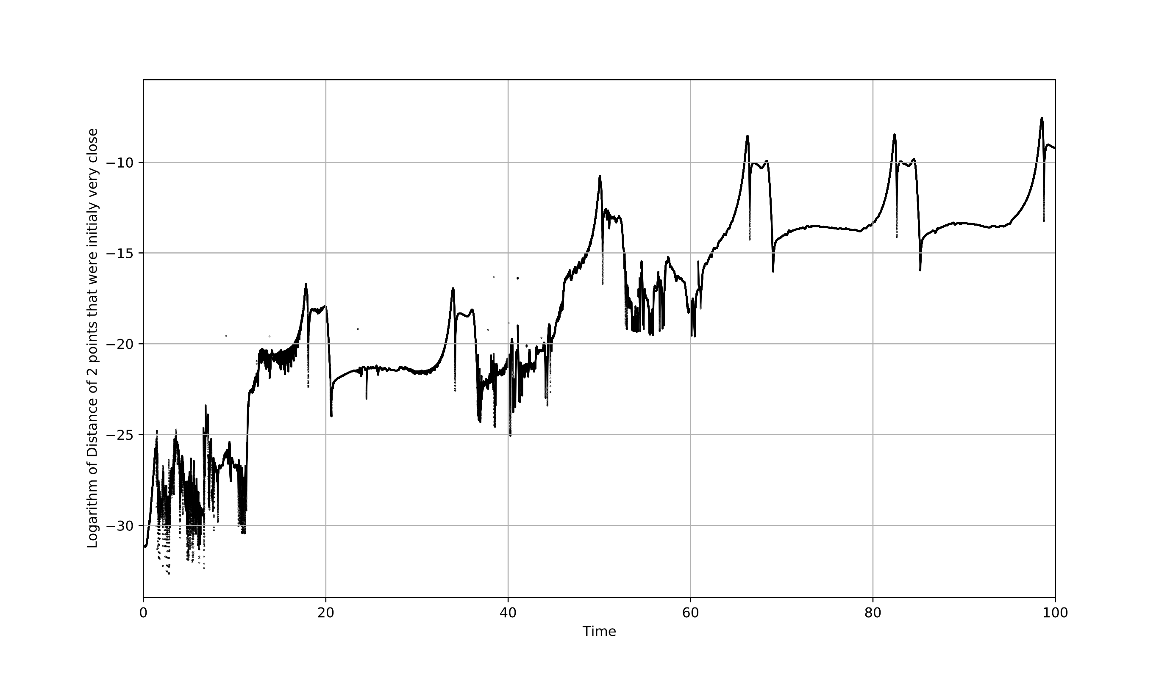
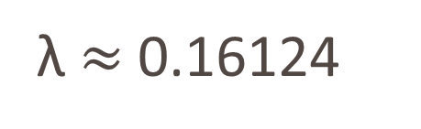
λ $≈$ 0.16124

Slide 6
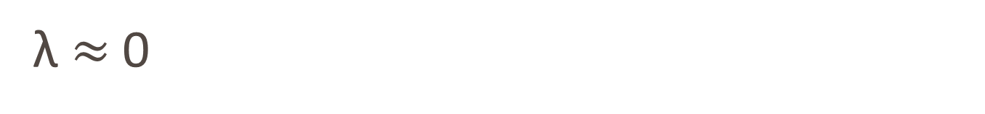
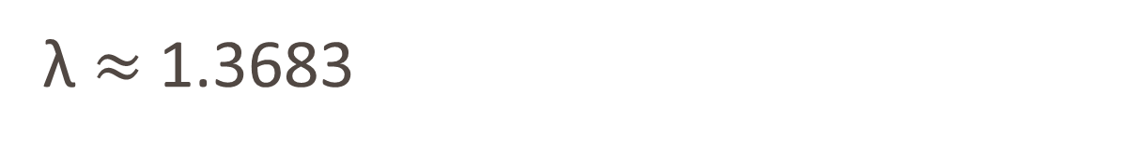
λ $≈$ 1.3683
λ $≈$ 0

Slide 7
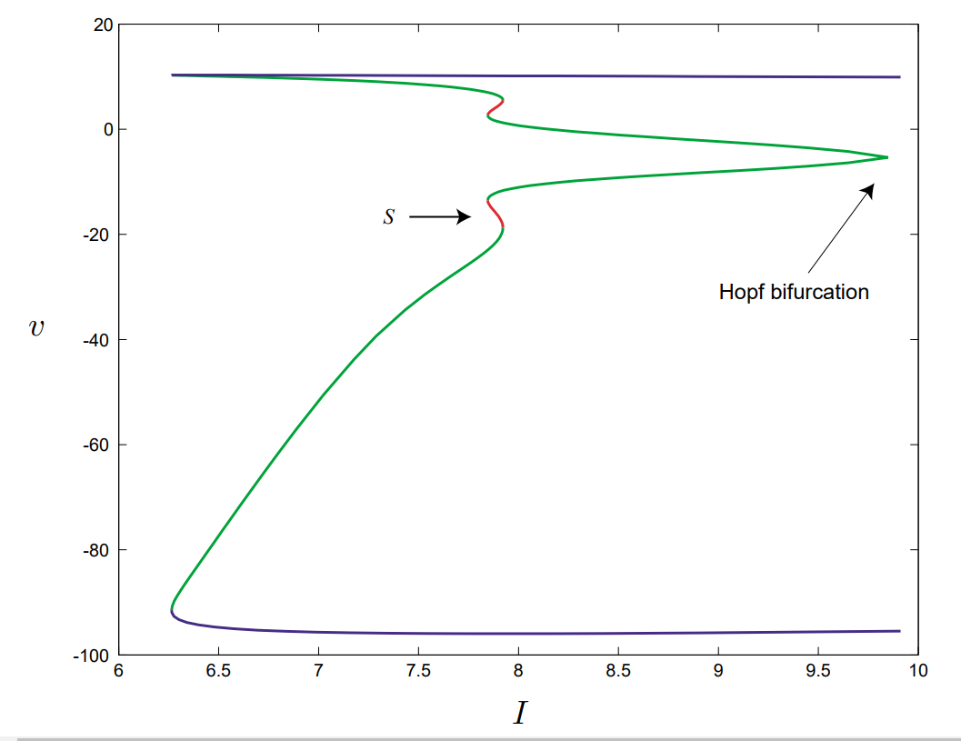
I = 7.86
Chaotic region

Slide 8
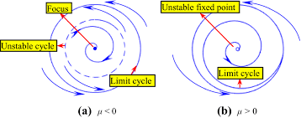
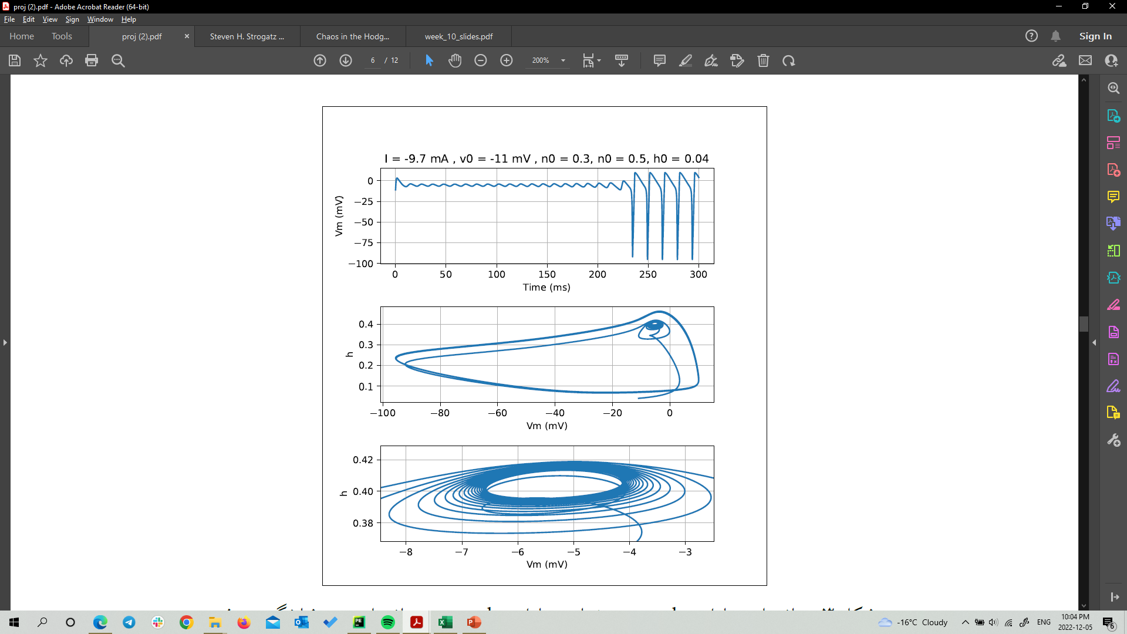
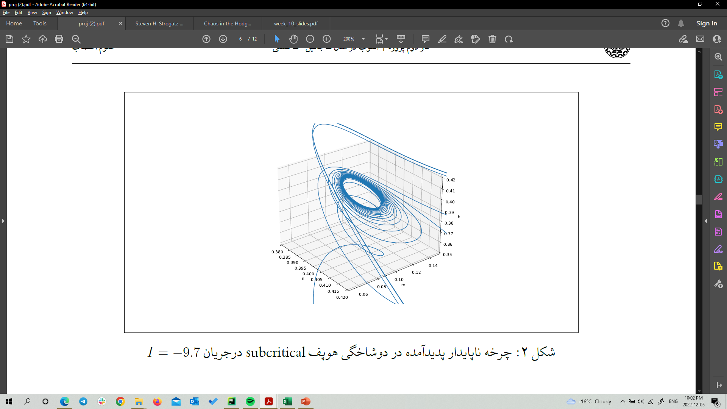
Subcritical Hopf bifurcation

Slide 9

Critical current to see the period-doubling bifurcation in HH model
I $≈$ 7.86

Slide 10
In the paper, the author explores the existence of a Poincare map for the discrete HH model which is
proof of chaos in another definition. But I could not reproduce this result through simulations.
Conclusion
Imagining that H-H model is the real model describing a neuron and it is chaotic. We know in the brain
there are noises, so tuning the extrinsic current to a specific value in order to have chaos is impossible.
2. We know from experimental observations that neurons become numb and inactive to
a constant current after a time period. So H-H model is not realistic in this case.
3. In this paper, we are only considering constant currents. While we can explore sinusoidal currents. In this
Case our control parameters space are 2D (amplitude, frequency).

